Slide 1

Capstone Project Phase 2 Traveler’s Hub
Supervisor: Dr. Zeev Barzily
Shiran Giladi
Lev Velitsky
Project Number: 24-1-D-4

Slide 2
Introduction
Traveling requires detailed planning, whether you're a traveler or a tour operator. The process is often fragmented, lacking tools for seamless planning. We would like to present an opportunity for a comprehensive solution to simplify and enhance trip planning.
Notes:
We would like to present to you the complexities of trip planning and the solution we've developed to streamline this process. Imagine you want to go on an organized trip, whether it's with your family or friends. You need to choose destinations, manage your budget, and look for reviews and tips. It can quickly become overwhelming, especially with the multitude of options and information available online. This is where Traveler's Hub comes in.
Traveler's Hub is a web application designed to simplify trip planning for both travelers and tour operators. It aims to provide a unified platform that integrates all aspects of the planning process. Today, we will outline the background that led to the development of Traveler's Hub, describe its key features and how they work together, and discuss our verification program to ensure the quality of our work.

Slide 3
The Problem
Time consuming
Unique travel experiences
Travelers need to rely on multiple websites and platforms to gather information and reviews.
Tour operators need to reach their target audience—potential customers—and showcase their offerings effectively.

Slide 4

The Solution
Traveler's Hub is a web application that aims to simplify the trip
planning process by providing a platform that integrates all aspects of
trip planning. It is designed to cater to both individual travelers and tour
operators, offering a seamless and efficient solution for creating and
managing travel plans.
Traveler’s Hub
Notes:
Traveler's Hub is a web application that aims to simplify the trip planning process by providing a unified platform that integrates all aspects of trip planning. It is designed to cater to both individual travelers and tour operators, offering a seamless and efficient solution for creating and managing travel plans.

Slide 5

Features
Trip Search
Trip Details
Booking
User can look for trips and read the Adventure Canvas.
Each trip contains images, duration, cost, itinerary, available dates for booking, etc.
Travelers can book their desired trips.
Notes:
Users can search for trips and apply filters using destination and dates. Each trip contains Adventure Canvases as a conceptual basis for trip plans. Adventure Canvases provide thematic outlines for trips, including key events, descriptions, images, and forums for discussion.
Users can also view all planning trip details, which include itinerary, available dates for booking, travel guide, and more.
They can book their desired trip when it is open for registration.

Slide 6
Unique Features
Forum
Concept
Promote a Concept
On each trip, users can open a forum to discuss, ask questions, give tips, and more.
Travelers can create a trip concept as they like.
If a user concept receives a lot of attention, the tour operator can promote it to an actual trip.
Notes:
Forums linked to Adventure Canvases encourage active community engagement, allowing users to discuss travel ideas, provide feedback, and share experiences.
Concepts are preliminary trip ideas with potential activities and attractions. Travelers can create Concepts and receive community feedback and discussion. Tour operators can promote user-generated Concepts into Adventure Canvases, signaling the transition from idea to actionable trip plan.
******* explanation on how those unique features solve the problems we introduce *******
With the Forums linked to Adventure Canvases, we’re solving the problem of isolation in trip planning. Travelers no longer need to struggle on their own; they have access to a vibrant, engaged community, and tour operators have a platform to directly interact with potential customers.
With Concepts, we're solving the problem of fragmented planning. Travelers can start with simple ideas and get community feedback, while tour operators can step in to turn those ideas into full, actionable itineraries.
In essence, Traveler’s Hub unites travelers and tour operators on a single platform—offering a comprehensive solution to a once frustrating and disjointed process.

Slide 7
Main System Requirements
01
02
03
04
Unified Trip Planning Platform
User Profiles
Separate functionalities for travelers and tour operators.
Single system for trip search, booking, and management.
Community Features
Secure and Efficient System
Forums and collaborative trip creation (concepts).
Secure user authentication and fast data handling.
Notes:
The main goal of Traveler’s Hub is to provide a unified platform for all aspects of trip planning. Users can create profiles, search for trips, and manage bookings. For tour operators, there are tools to create and promote travel packages. Community features like forums allow travelers and tour operators to collaborate and share ideas, creating a more interactive travel planning experience. Lastly, security and efficiency are key, with secure authentication and fast data handling.

Slide 8
Non-Functional / Functional Requirements
Functional | Non-Functional
User Registration and Authentication (Traveler and Operator roles) | Performance - Fast response times and real-time updates
Trip Search and Booking | Security - Secure password storage (bcrypt) and authentication
Concept Creation and Promotion | Usability - Mobile responsiveness and cross-browser compatibility
Forum Discussions | Data Management - MongoDB ensures efficient handling of large datasets
Admin Management for Trips | -

Slide 9
Technologies & Tools Used
Frontend: React.js
Backend: Node.js, Express
Database: MongoDB
Development Tools:
Postman for API testing
Jest for automated testing
Socket.io for real-time communication
Notes:
The frontend is built with React.js, providing a dynamic user interface.
The backend relies on Node.js and Express to handle the business logic and API endpoints.
MongoDB serves as the database to manage user data and trip details.
We also used Postman for API testing, Jest for automated testing, and Socket.io for real-time forum interactions.
This setup ensures a seamless and responsive user experience.

Slide 10
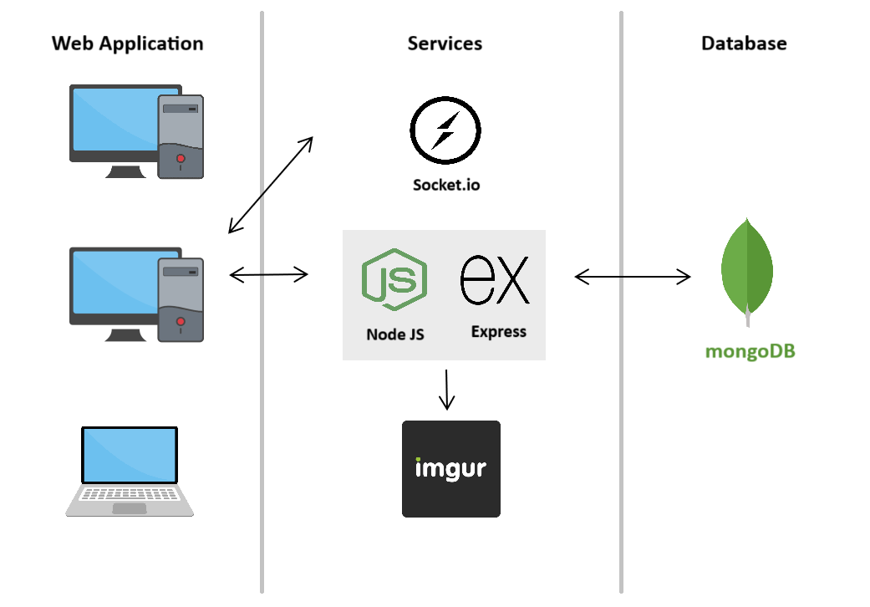
Software Architecture
Notes:
Here we can see the architecture of the application. It is designed to provide a seamless and dynamic user experience, real-time communication, and efficient data handling and storage. This architecture follows a client-server model, where the frontend, as previously mentioned, is built with React and interacts with a Node.js and Express-based backend. We can also see the interaction with Socket.IO for live chat functionality and the integration with Imgur for external image storage, ensuring that the application is both scalable and responsive.

Slide 11
Challenges and Problems

Slide 12
Image Storage
Challenge: Storing user profile pictures and trip images in the database.
Problem
Storing images as base64 strings led to
Slow upload and retrieval times.
Errors when fetching multiple images.
Constraints
Limited database performance.
Need for fast image loading times.
Solution
Integrated with Imgur for image storage
Stored image URLs in the database.
Used Imgur’s API with access token to upload images.
Benefits
Faster upload and retrieval times.
Reduced database load and eliminated errors.
Notes:
One of the challenges was determining the best way to store images, such as user profile pictures and trip images. Initially, we thought storing images directly in our database by converting them into base64 strings would be an easy solution. However, this approach presented several problems.
Because these image strings were quite large, the upload times became significantly slower. Not only did this impact the user experience, but it also put a strain on our database performance. Additionally, when fetching multiple images, especially on a page where there were many trips, we would encounter errors.
So, we needed to find a better way to store these images.
To address the challenge, we decided to use Imgur, Imgur is an image hosting service. This meant that instead of saving the entire image data as strings in our database, we would only store the URLs pointing to where the images were hosted on Imgur.
We integrated Imgur’s API into our system and used a POST request along with an access token to securely upload the images to Imgur. By doing this, we improved the speed of saving and loading images. And we reduced the load on our database and eliminated the errors we were encountering when handling multiple image requests.

Slide 13
Live Chat Integration
Challenge: Implementing real-time updates in the chat system.
Problem
Users had to refresh the page to see new messages.
Constraints
Ensuring real-time communication without page refreshes.
Handling multiple simultaneous users.
Solution
Integrated Socket.io for real-time updates.
Server pushes updates as soon as new data arrives.
Instantly reflects new comments or user interactions.
Benefits
No need for page refreshes.
Seamless and interactive user experience.
Notes:
Another challenge was enabling real-time communication between users. We wanted users to be able to chat with each other and participate in forums, but the problem was that our initial implementation required users to refresh the page to see new messages or updates. This was a huge limitation because real-time communication should feel instant, especially when multiple users are interacting in a forum.
To solve this challenge, we decided to implement Socket.io. Socket.io is a framework that allows for real-time, bidirectional communication between the server and client.
With Socket.io, whenever a user posts a new message or interacts with a forum element, like liking or disliking a post, the server immediately pushes the update to all connected clients. This means users no longer need to refresh their page to see new messages or updates.

Slide 14
Secure Password Hashing
Challenge: Storing user passwords securely.
Problem
Storing passwords in plain text poses security and privacy risks.
Constraints
Need for strong encryption.
Protect user data against potential breaches.
Solution
Used bcrypt with a random salt for password hashing.
Password combined with a unique salt before hashing.
Hashing done using bcrypt, a slow hash function.
Benefits
Protects passwords against brute-force attacks.
Even if the database is compromised, plain passwords are not exposed.
Notes:
Another challenge was storing user’s passwords, we could not save them as a plain-text, duo to privacy and security risks. If the database were ever compromised, users' passwords could be easily exposed, leading to potential data breaches.
So, we implemented a password hashing mechanism using bcrypt, which is a well-known and secure algorithm.
When a user creates or updates their password, we generate a random salt, which is a unique string of data, and combine it with the password before hashing.
By using this method, even if our database were to be compromised, an attacker would not have access to the plain-text passwords.

Slide 15

Project Indicators
Completion of Functionalities: Trip planner, search, and booking are fully implemented
Community Engagement: Concept creation and forum features are live.
Technical Performance: Secure, real-time forum discussions using Socket.io.
Mobile & Browser Compatibility: Successfully tested on multiple devices.
Notes:
We measure success based on key indicators.
The core functionalities, such as trip planning and forum engagement, are fully implemented.
Technical performance meets expectations, particularly with the real-time chat feature in the forums, powered by Socket.io.
Additionally, the platform works across various browsers and devices, ensuring accessibility for all users.

Slide 16
Our System

Slide 17

Our System

Slide 18
Thanks!

